Slide 1
Taylor Series Revisited

Slide 2
Taylor Series Revisited

Slide 3
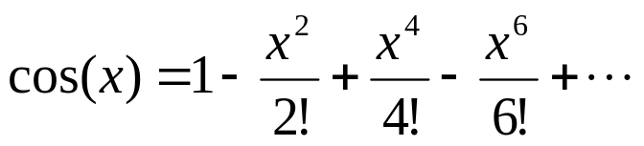
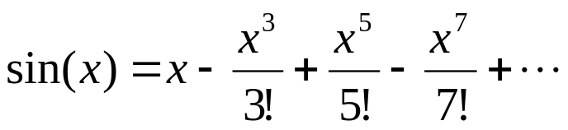
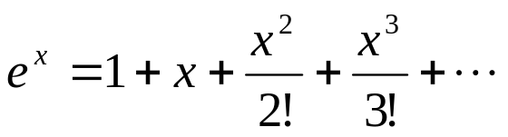
What is a Taylor series?
Some examples of Taylor series which you must have seen

Slide 4
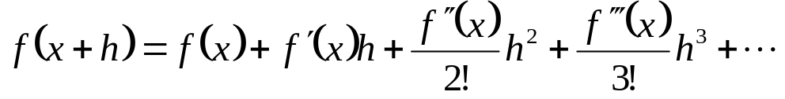
General Taylor Series
The general form of the Taylor series is given by
provided that all derivatives of f(x) are continuous and exist in the interval [x,x+h]
What does this mean in plain English?
As Archimedes would have said, “Give me the value of the function at a single point, and the value of all (first, second, and so on) its derivatives at that single point, and I can give you the value of the function at any other point” (fine print excluded)

Slide 5
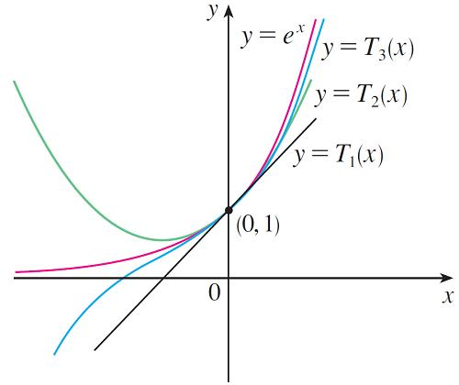
Approximating Functions by Polynomials
Notice also that T₁ and its derivative have the same values at a that f and f  have. In general, it can be shown that the derivatives of T_{n} at a agree with those of f up to and including derivatives of order n.
To illustrate these ideas let’s
take another look at the graphs
of y = e^{x} and its first few Taylor
polynomials, as shown in Figure 1.
Figure 1

Slide 6
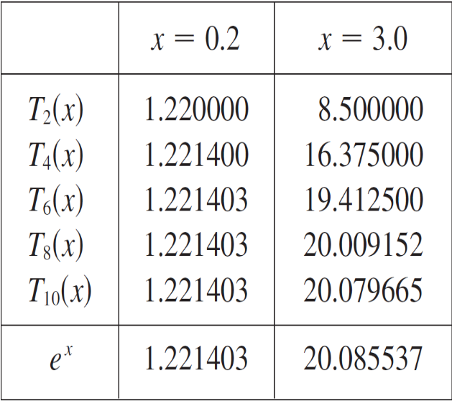
Approximating Functions by Polynomials
The values in the table give a numerical demonstration of the convergence of the Taylor polynomials T_{n} (x) to the function y = e^{x}. We see that when x = 0.2 the convergence is very rapid, but when x = 3 it is somewhat slower.
In fact, the farther x is from 0, the
more slowly T_{n} (x) converges to e^{x}.
When using a Taylor polynomial
T_{n} to approximate a function f, we
have to ask the questions:
How good an approximation is it?

Slide 7







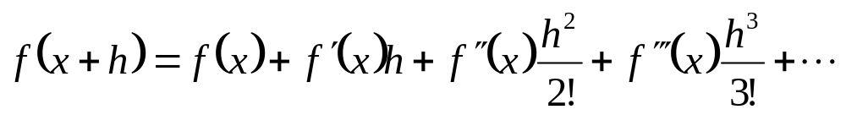

Example—Taylor Series
Find the value of
given that
and all other higher order derivatives
of
at
are zero.
Solution:

Slide 8
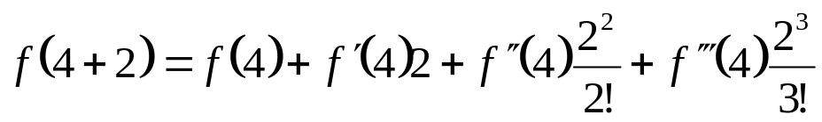
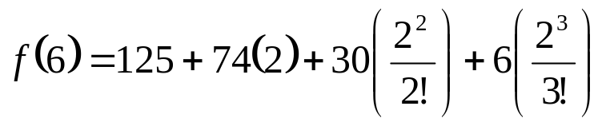


Example (cont.)
Solution: (cont.)
Since the higher order derivatives are zero,
Note that to find
exactly, we only need the value
of the function and all its derivatives at some other point, in this case

Slide 9
Derivation for Maclaurin Series for e^{x}
Derive the Maclaurin series
The Maclaurin series is simply the Taylor series about the point x=0
http://numericalmethods.eng.usf.edu

Slide 10
Approximating Functions by Polynomials
How large should we take n to be in order to achieve a desired accuracy? To answer these questions we need to look at the absolute value of the remainder:
| R_{n} (x) | = | f (x) – T_{n} (x)|
There are three possible methods for estimating the size of the error:
1. If a graphing device is available, we can use it to graph
| R_{n} (x) | and thereby estimate the error.

Slide 11

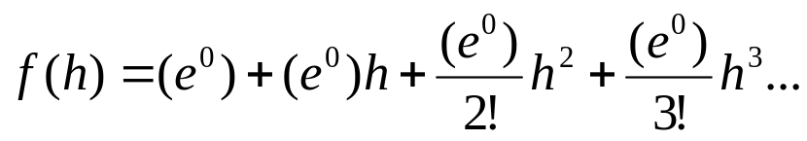
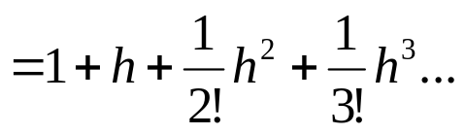
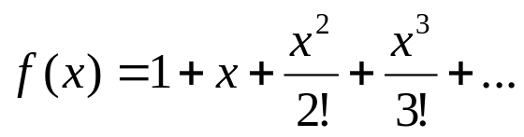
Derivation (cont.)
Since
and
the Maclaurin series is then
So,

Slide 12
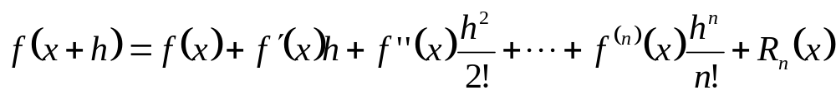
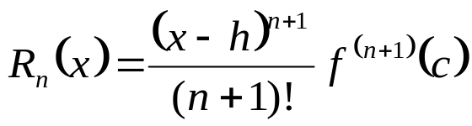

Error in Taylor Series
The Taylor polynomial of order n of a function f(x) with (n+1) continuous derivatives in the domain [x,x+h] is given by
where the remainder is given by
where
that is, c is some point in the domain [x,x+h]

Slide 13


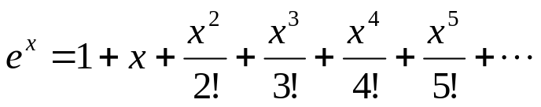
Example—error in Taylor series
The Taylor series for
at point
is given by
It can be seen that as the number of terms used
increases, the error bound decreases and hence a
better estimate of the function can be found.
How many terms would it require to get an approximation of e¹ within a magnitude of true error of less than 10^{-6.}

Slide 14

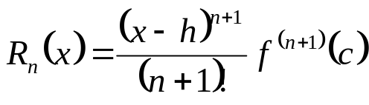

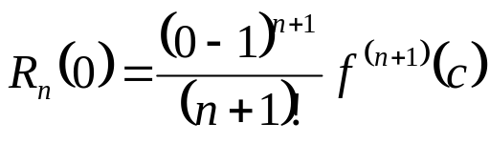
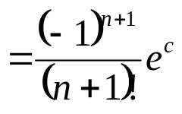

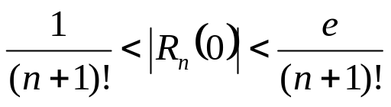

Example—(cont.)
Solution:
Using
terms of Taylor series gives error
bound of
Since

Slide 15


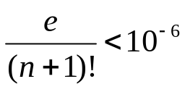



Example—(cont.)
Solution: (cont.)
So if we want to find out how many terms it would
require to get an approximation of
within a
magnitude of true error of less than
,
So 9 terms or more are needed to get a true error
less than

Slide 16
THE END

